Slide 1


Analytical Report
By
Durga Kudale

Slide 2

Todays’ Agenda
Introduction
Problem
Process
Insights
Summary

Slide 3

Online Retail
Online retail refers to the process of selling goods and services over the internet.
Growth of Online Retail Industry: Provide statistics on the growth of online retail globally and in key markets.
Importance of Analytics in Online Retail: Explain how analytics helps online retailers make data-driven decisions to improve performance.

Slide 4
Problem
The CEO and CMO to provide visuals on the metrics that they wish to analyse for the online retail store.
They want to understand how their business is performing and what areas are the key strengths of the company.
They are also focused on identifying opportunities that would lead to growth and generate more revenue in the future.

Slide 5
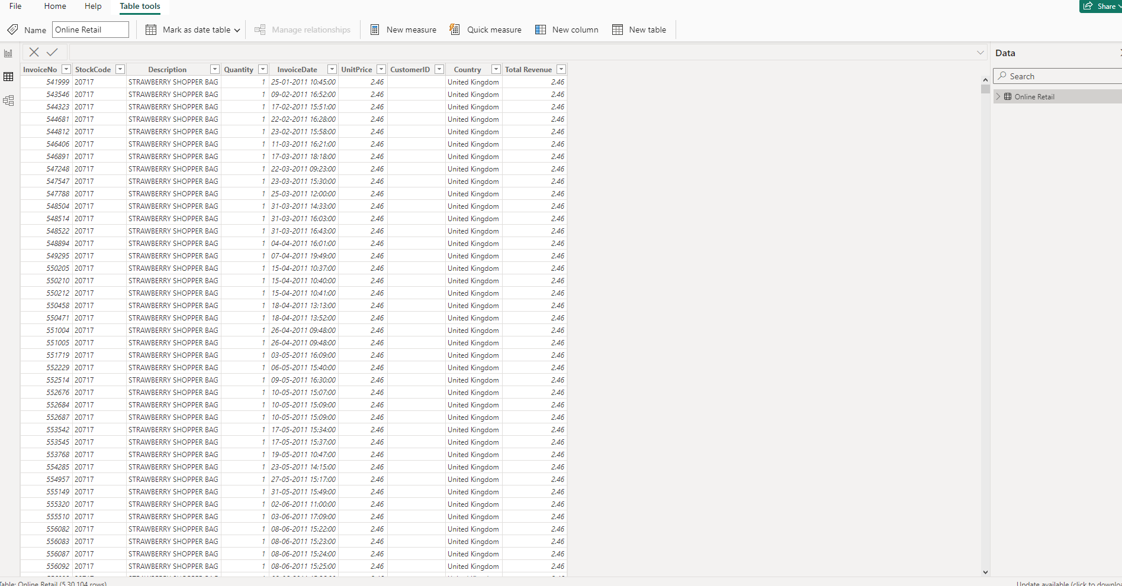
Data understanding and Data Cleaning
File is in .xlsx and it has 541910 records.
Check that the quantity should not be below 1 unit
Check that the Unit price should not be below $0

Slide 6

Retail Insights And
Summary

Slide 7
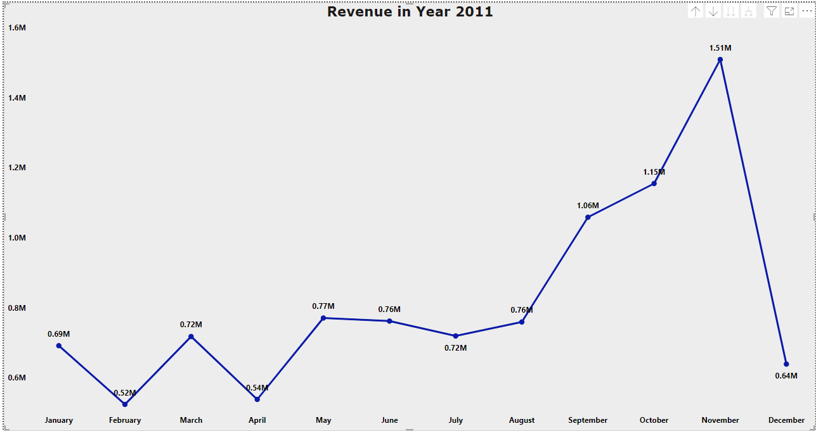
According to our statistical analysis the sales from January to August are stable. The increasing revenue begins in September till November. November show high revenue with 1.51M. This analysis shows how seasonality happens in last four months of the year 2011.

Slide 8
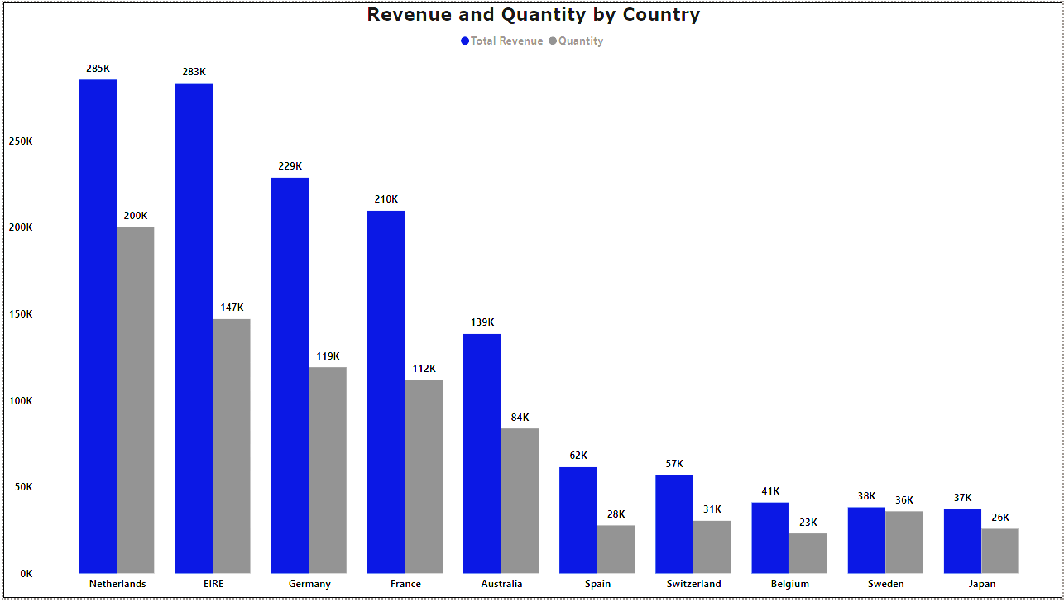
According to data quantity and revenue are quite high in countries like Netherlands, Ireland, Germany, and France. These markets I will propose to concentrating on this countries.

Slide 9
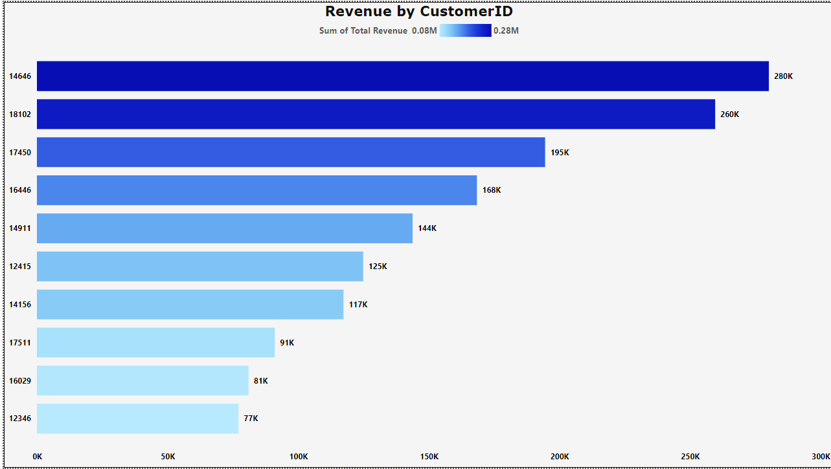
According to Third scenario there are not many differences between the top 10 costumers. The highest consumer spends 17 % more than the second highest consumer. That the company does not rely only on a small number of consumers to generate income.

Slide 10
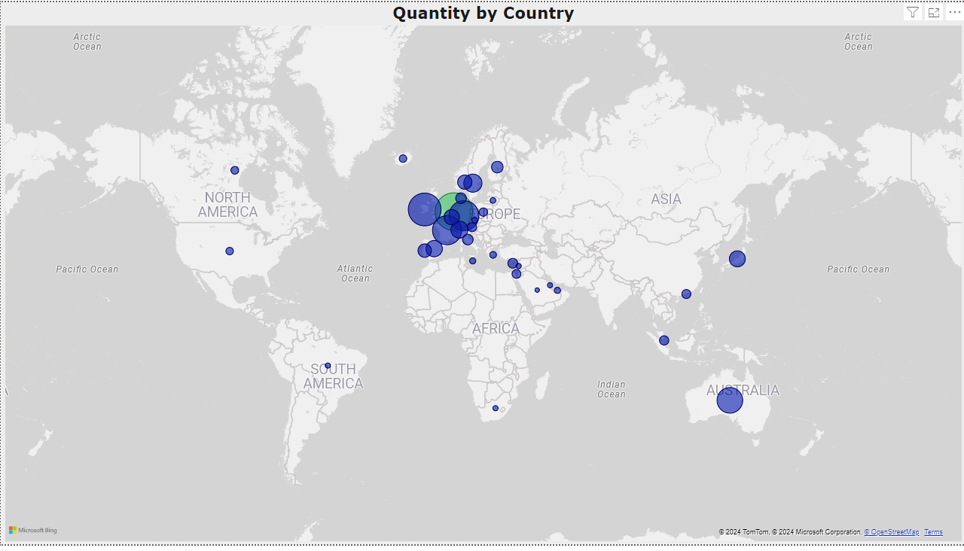
Regarding fourth scenario, Map chart states that apart from United Kingdom Netherlands, Ireland, Germany, France and Australia generate large profit and revenue. And the company should invest more in these nations to boost product demand.

Slide 11
Summary

Slide 12
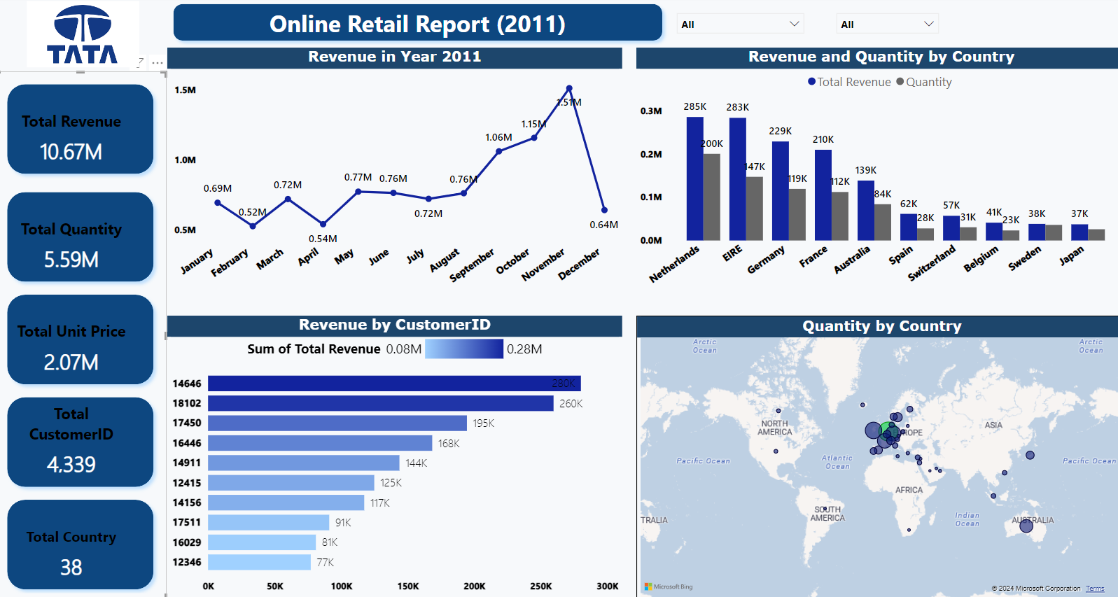

Slide 13
Conclusion

Slide 14
Thank You!

